Slide 1
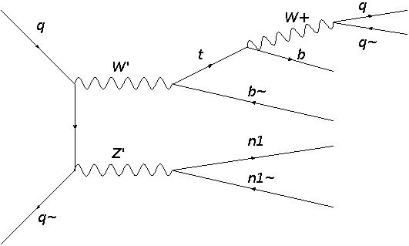
Signal & selection
Preselection:
1) 4 jets – 2 b-tagged, 2 not b-tagged
2) Each jet requires* p_{T} > 20 GeV,
|η| < 2.5
3) Veto events with electron or muon
that has p_{T} > 10 GeV, |η| < 2.5
4) MET >= 50 GeV
* I just followed the practice on the mono-Z’
paper. Any good reason for it?

Slide 2
Cuts
Reconstructing W’:
1) Among non-b-tagged jets,
find the best 2 whose M_{jj} is closest to
the mass of W+ (~80 GeV)
Select only if
(The numbers here are completely arbitrary)
2) Among the b-tagged jets,
find the best 1 whose M_{wb} is closest to
the mass of t (~173 GeV)
Select only if
3) With the remaining b-tagged jet,
combine to find M_{tb}
M_{tb} represents reconstructed W’ mass

Slide 3
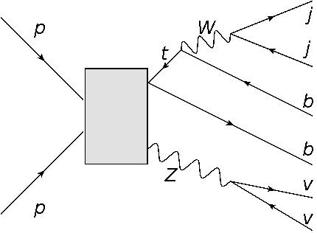
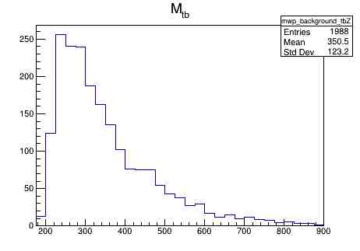
Background events
1) t b Z →→ 2 jets, 2 b-tagged jets, MET
    t → W b, W → j j
    Z → v v (neutrinos register as missing p_{T})
Cross section: 0.001167 +/- 1.5e-06 pb
Generated: 40,000 events
Selected: 1,988 events

Slide 4
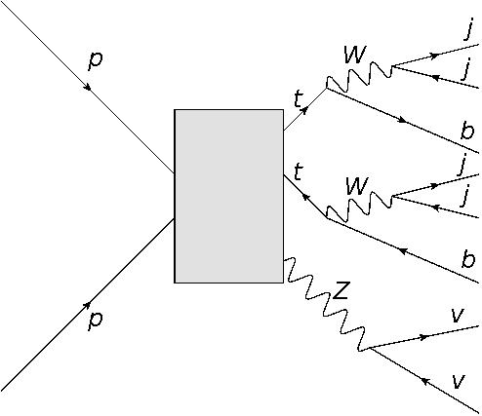
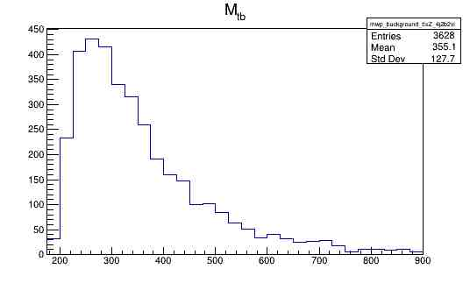
Background events
2) t t Z →→ 4 jets, 2 b-tagged jets, MET
    t → W b, W → j j for both top quarks
    Z → v v (neutrinos register as missing p_{T})
Cross section: 0.001167 +/- 1.5e-06 pb
Generated: 40,000 events
Selected: 3,628 events

Slide 5
Background events
1) t b Z →→ 2 jets, 2 b-tagged jets, MET
    t → W b, W → j j
    Z → v v (neutrinos register as missing p_{T})
Cross section: 0.001167 +/- 1.5e-06 pb
Generated: 40,000 events
Selected: 1,988 events

Slide 6
Background events

Slide 7


